Slide 1
New Smart Valve Modification Test
29-06-2019

Slide 2
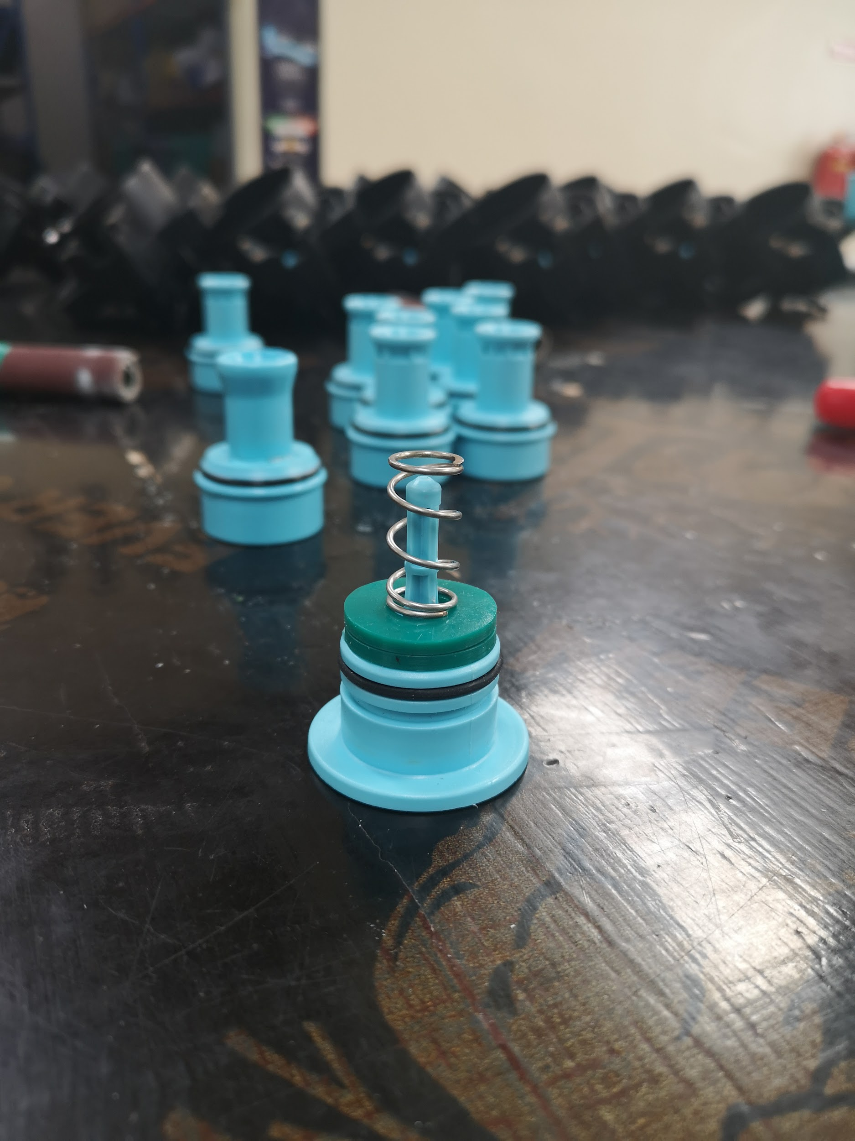
Modification
Steps
Inserted the 24x2 Rubber O-ring that snugly fit to the groove.
Added extra 2.5mm silicone gasket to air dock housing as shown
Smooth surface of the silicone rubber gasket face upwards.
No glue applied between the silicon gaskets
Aligning the rubber silicon gasket
Observation
Found several 24x2 rubber O-ring that are slightly large than groove internal diameter of dock air housing
Two Silicon Gaskets
24 x 2 O-Ring

Slide 3
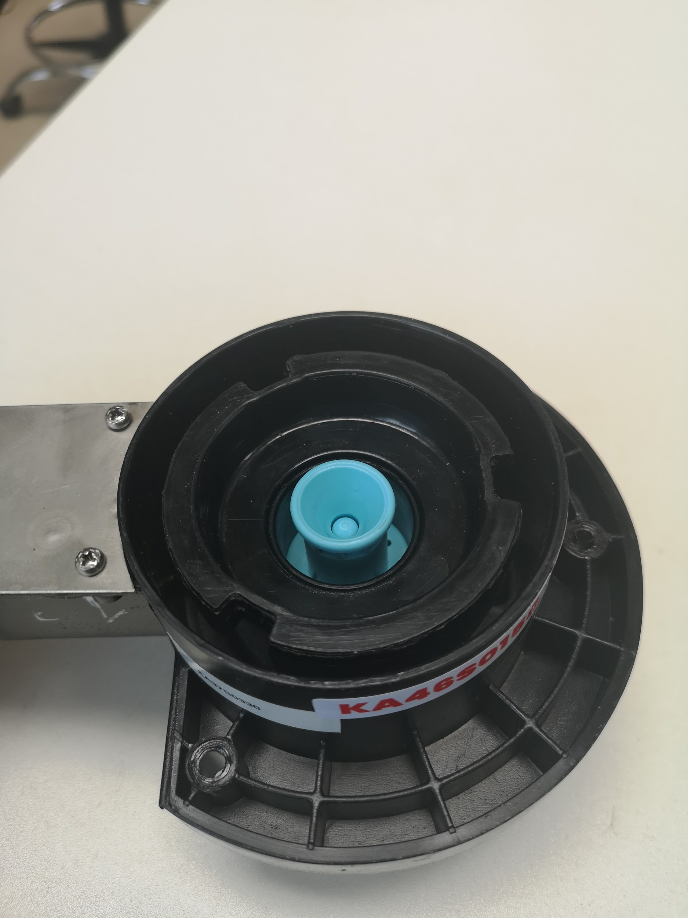
Assembly
3 smart valve were reworked and the second silicon gasket was added
Report of the 3 Reworked smart valve with 2 silicone rubber gasket
KA46S0158
KA46S0105
KA46S0109

Slide 4
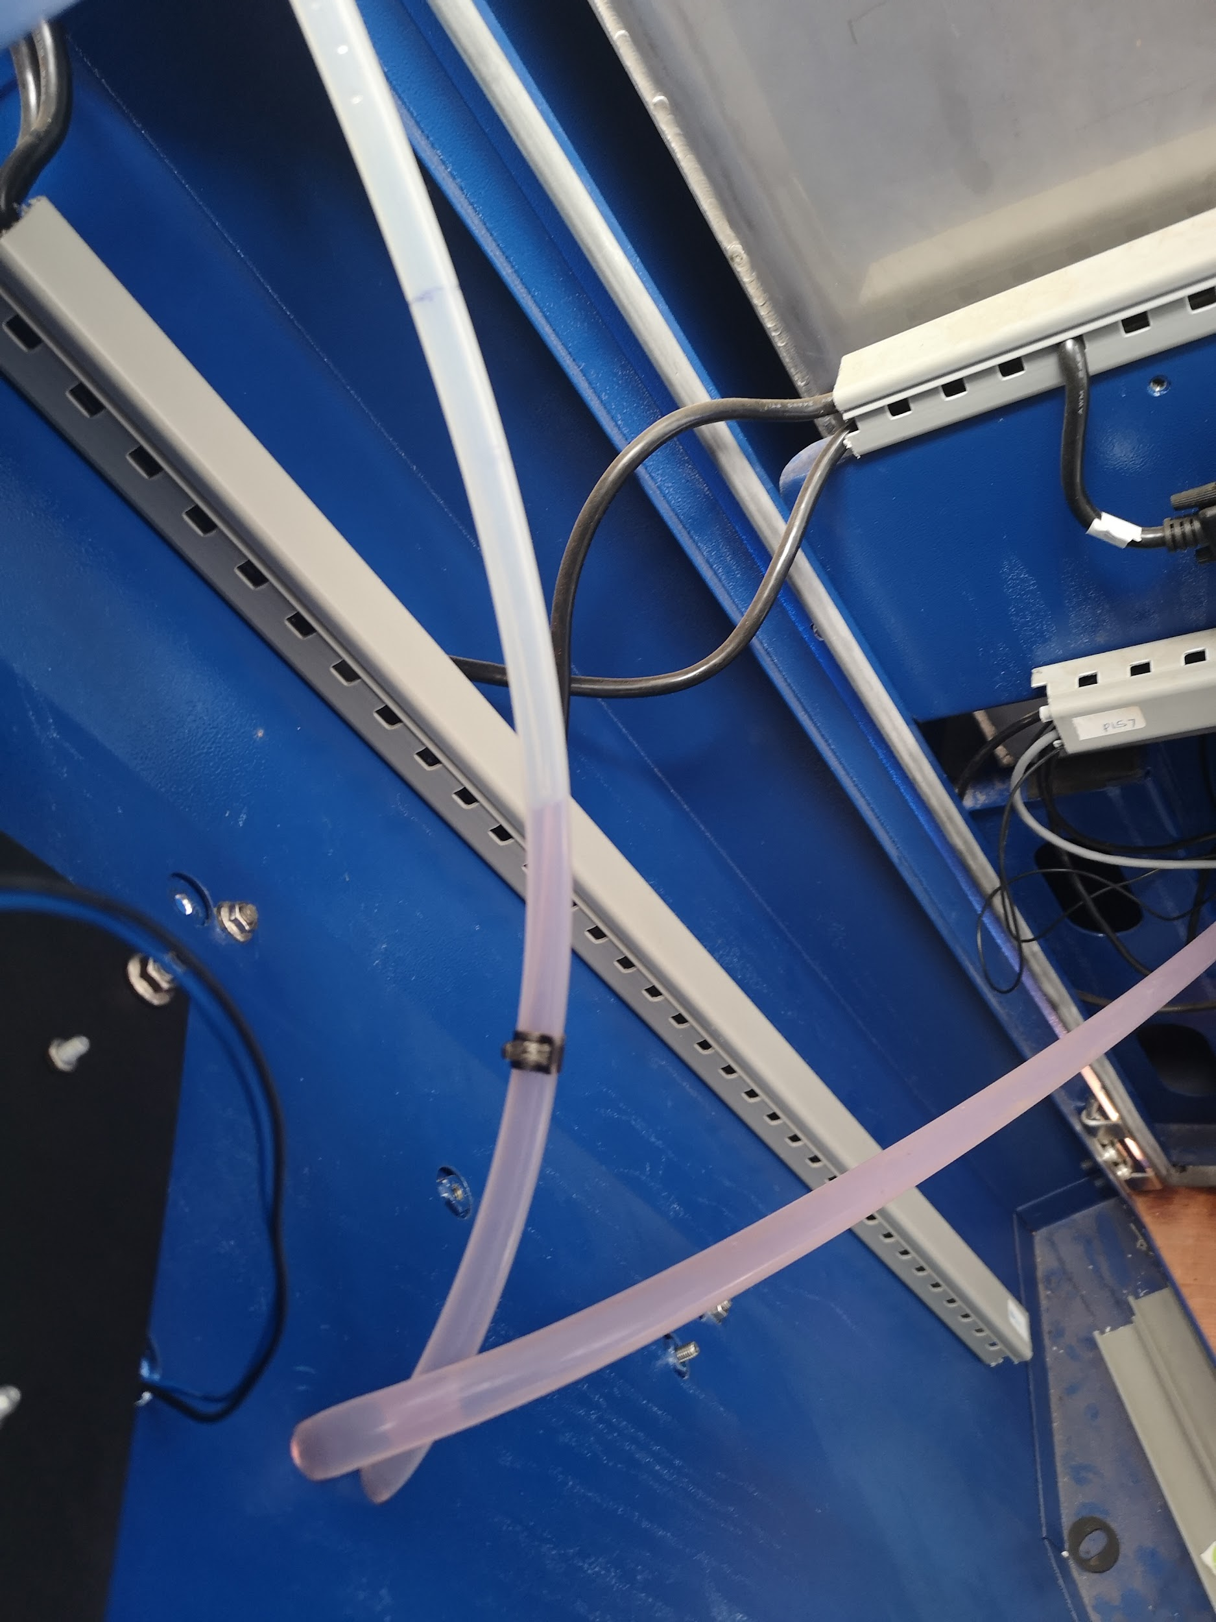
Functionality QC Test
Air Line Pipe
Initial Functionality QC
During the initial/first dispense of the 2 litres no fuel observed on dispense air silicone pipe.
After 5 dispenses of 2 litres fuel observed on the dispense air line is less than 12ML
No flooding was observed after 5 successful dispense.
All the 3 smart valve QC Passed the functionality process having gone through 5 dispenses each of 2 Litres .
12ML Mark
Fuel Level after 5 dispenses of 2 Litres
Fuel Line Pipe

Slide 5
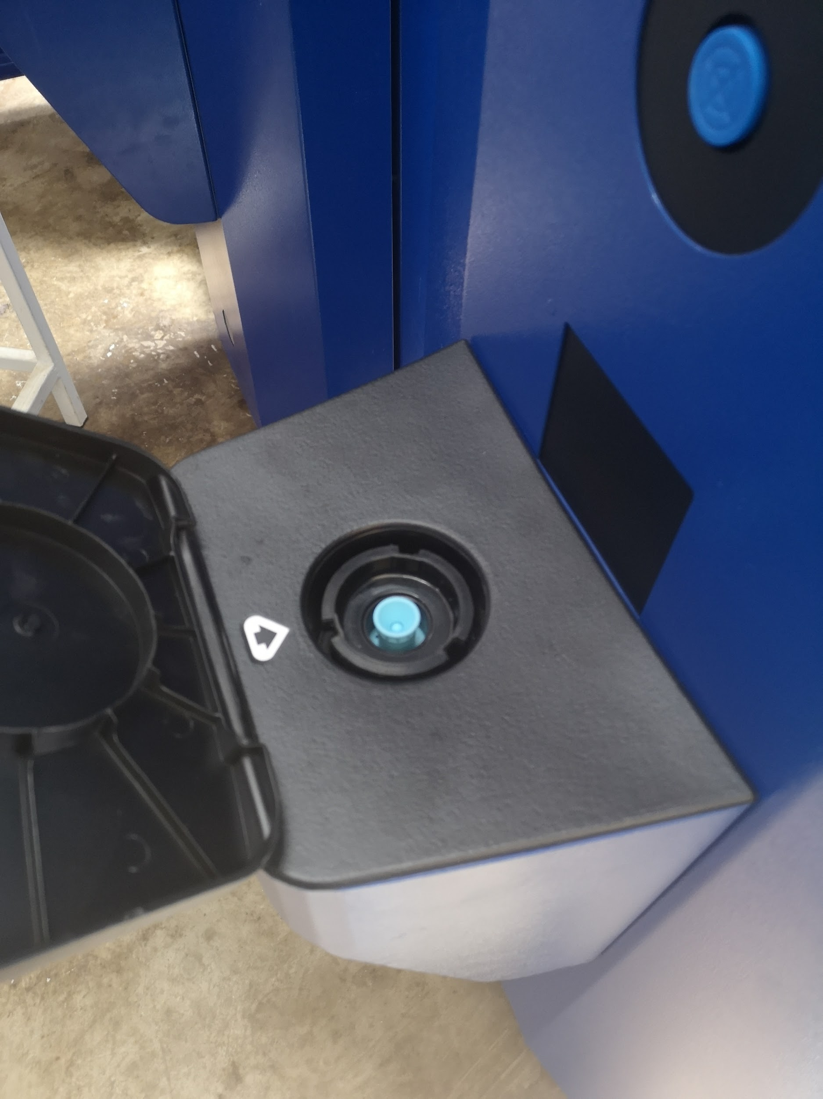
Stress test & Dispense Test
The three Reworked smart valve(with 2 silicon rubber gasket) were handed over to QA final assembly for stress test and dispense test and final assembly QA area
20-30 dispense of 2 litres were done to each smartvalve
No flooding was observed during after the 20-30 dispense
Less than 12ML litres of fuel on the air line was observed
No wear and tear was observed on dock housing the after 20-30 dispense
The three Reworked smart valve with 2 silicone gasket QC Passed the stress and dispense test

Slide 6
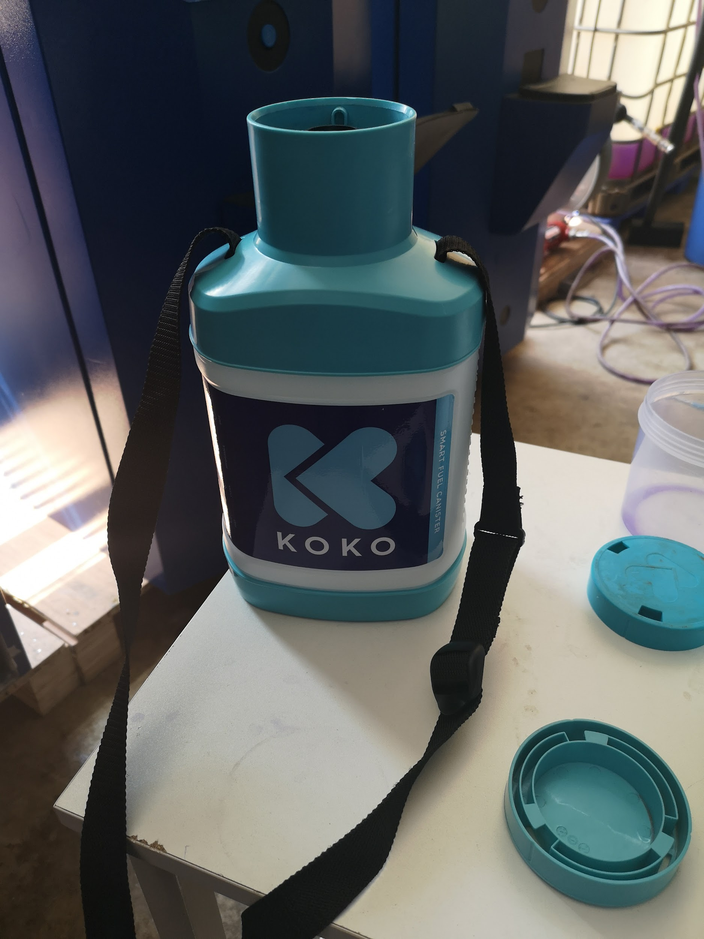
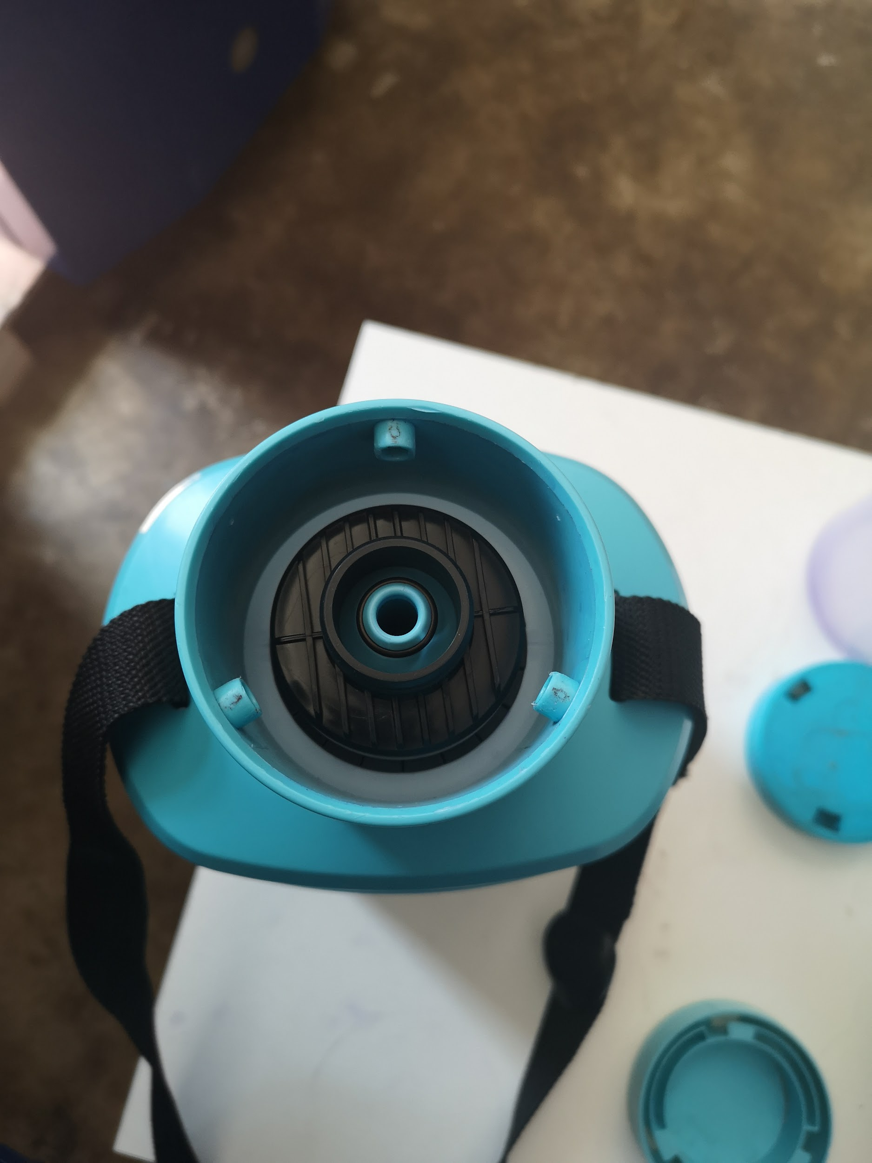
Canister Docking
No wear and Tear Observed
During the dispense test, docking and undocking of the canister was ease with minimal friction
No tear and wear was observed on canister dock fuel housing
No loosening of the canister during 20-30 dispense of each 2 Litres

Slide 7
Observation,Suggestion and Conclusion
Observation
Some 24 x 2 O-ring are larger than the diameter of the groove of the air dock housing
Some 24 x 2 O-ring are “Thicker” that cause high friction between the air and fuel dock housing- When fuel dock housing is pressed /mate with air dock housing it release slowly
One side of the 2.5mm silicone rubber gasket is rough
Suggestion
Add the thickness of the silicone rubber gasket to around 3.5mm
both side of the 2.5mm silicone rubber gasket should be smooth

